Slide 1

University Management System
Domain: Academic EdTech | Team: Ahmed Mostafa , Gihad

Slide 2

The Problem
Universities struggle daily with fragmented and siloed administrative data.
Administrators, instructors, and students lack a unified console to handle enrollments, grading, and scheduling. This disconnection leads to critical administrative errors, lost data records, and painfully delayed GPA calculations.

Slide 3


Project Idea
A centralized, robust C# console application designed for rapid data entry.
Digitally tracks the entire academic lifecycle from student registration to course enrollment.
Acts as the central nervous system for a university, seamlessly connecting users and processes.
Powered by solid OOP principles and generic data managers for ultimate reliability.

Slide 4





Solution & Features
User Management
Academic Core
Automated ID & secure university Email generation for both Students and Instructors (Full-time & Part-time).
Streamlined course creation, instructor assignment logic, and complex student enrollment tracking systems.
Evaluation Engine
Analytics Pipeline
A robust module dedicated to scheduling strict examinations and accurately recording student test results.
Automated, instantaneous GPA calculation based on raw scores, credit hours, and algorithmic course points.

Slide 5

Class Structure
Architectural Layer | Key Classes & Interfaces | Core Responsibility
Domain Models | Student, Course, Exam, Result | Define distinct business entities and encapsulate state data.
Abstract Interfaces | IManager, IResultService | Establish strict operational contracts for dependency injection.
Data Managers | GenericManager, CourseManager | Handle generic, highly reusable data persistence and CRUD logic.
Business Services | EnrollmentService, ExamService | Execute complex algorithmic rules and multi-entity orchestrations.

Slide 6
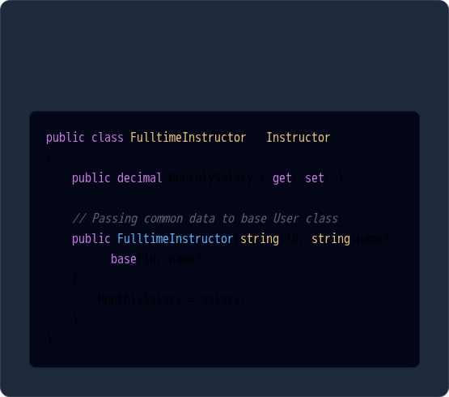
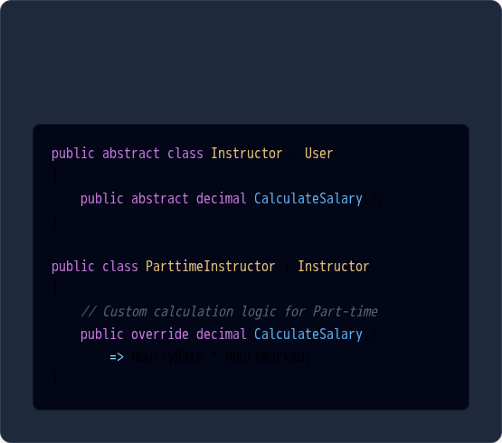
OOP Concepts I
Inheritance
Polymorphism
Constructors invoke base class logic.
Dynamic method overriding based on type.

Slide 7
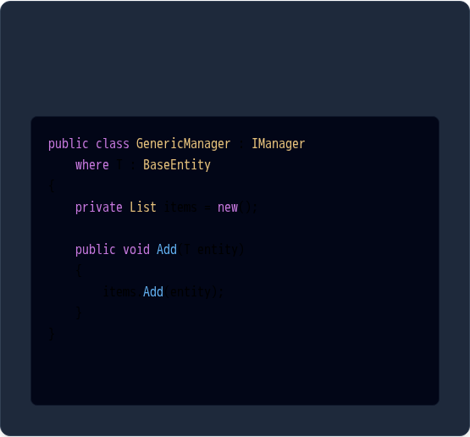
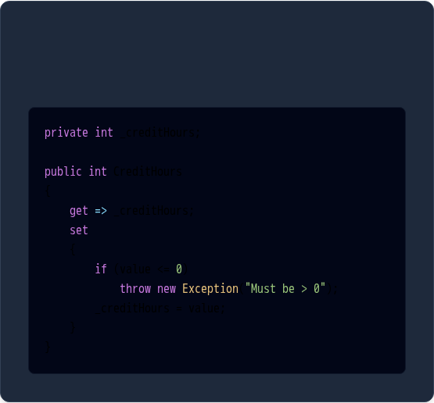
OOP Concepts II
Generics
Encapsulation
Reusable logic constrained by type.
Protecting internal state with logic gates.

Slide 8

Live Demo

Slide 9
https://drive.google.com/file/d/1sm9YPhriGbXiAMlrQubgPBBz6L8NW-zW/view?usp=sharing

